Slide 1
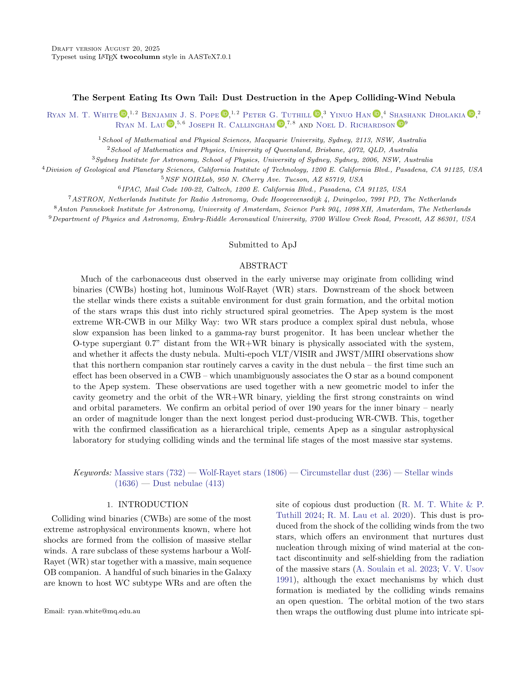



































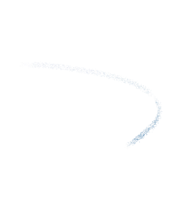







































































































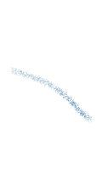
















































































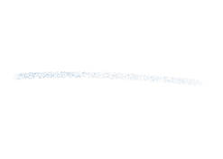



















































































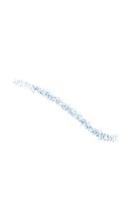



































There are mysterious spiral nebulae around some massive stars... Read all about it in my new paper titled:
Give it to me straight, doc:
Lots of massive stars, those much heavier than our Sun, come in pairs. These stars have ‘winds’, and since they are so close, their two winds smash together! This makes a hell of a lot of carbon soot which we can then image with our fancy telescopes. We use the (very fancy) James Webb Space Telescope to look at one such system - the Apep System, named after the Egyptian god of chaos - and we use this soot to figure out (almost) everything that’s going on. Turns out that there’s not just two, but three stars and it’s all very complicated!

Slide 2
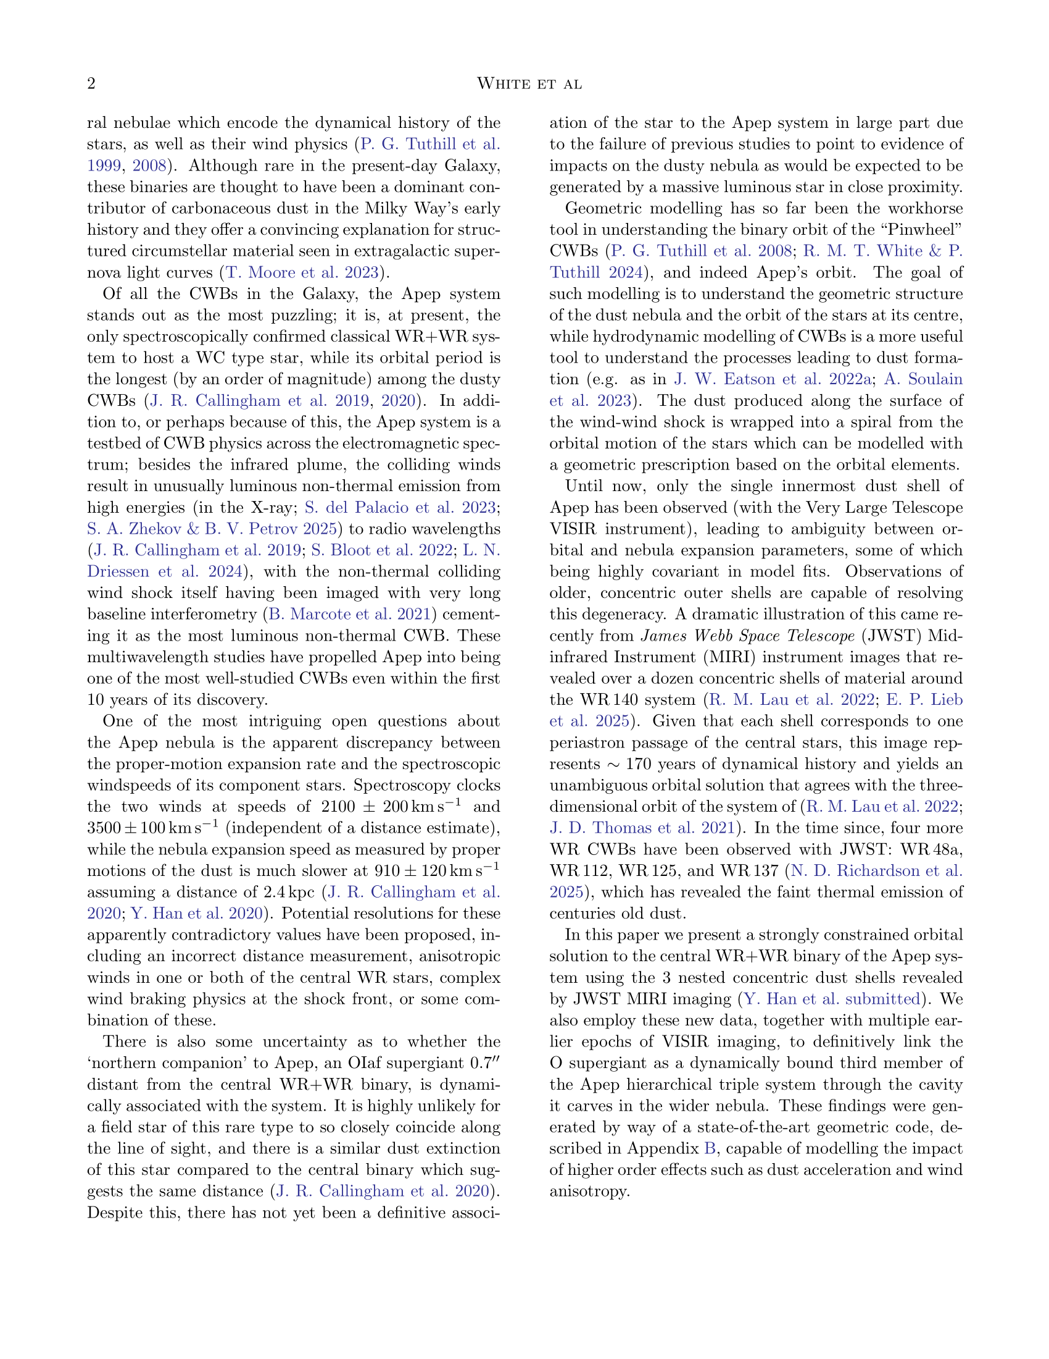











































































































































































































































































Okay, what are these systems and why do we care?
You’re probably familiar with the Sun. It’s a fairly average star. Most stars are a lot lighter than the Sun, and there are also many that are a *lot* heavier - some can be up to 100 times more massive. Those that are initially ~30 times or more as massive as our Sun will eventually get rid of most of their hydrogen, leaving behind a core of helium, carbon, and nitrogen. These cores are called ‘Wolf-Rayet’ stars - after the two French dudes who discovered them - and they are exceptionally bright stars, with unusually strong winds.
The (average) Sun
The much cooler (but actually hotter) Wolf-Rayet star
It might be strange to think of stars having winds, but our Sun does too! This is why we have aurorae on Earth: the solar wind interacting with our atmosphere. A Wolf-Rayet star’s wind is about a trillion times more powerful than that of our Sun. Almost 10 years ago, our team found a system with two of these Wolf-Rayet stars and they named it Apep. More about Apep soon...
Because Wolf-Rayet stars have no hydrogen, their winds are made up entirely of helium and carbon*. This means that they can be very efficient factories of carbon dust - jumbled together grains of carbon molecules. This dust goes on to form new Solar Systems and planets!

Slide 3
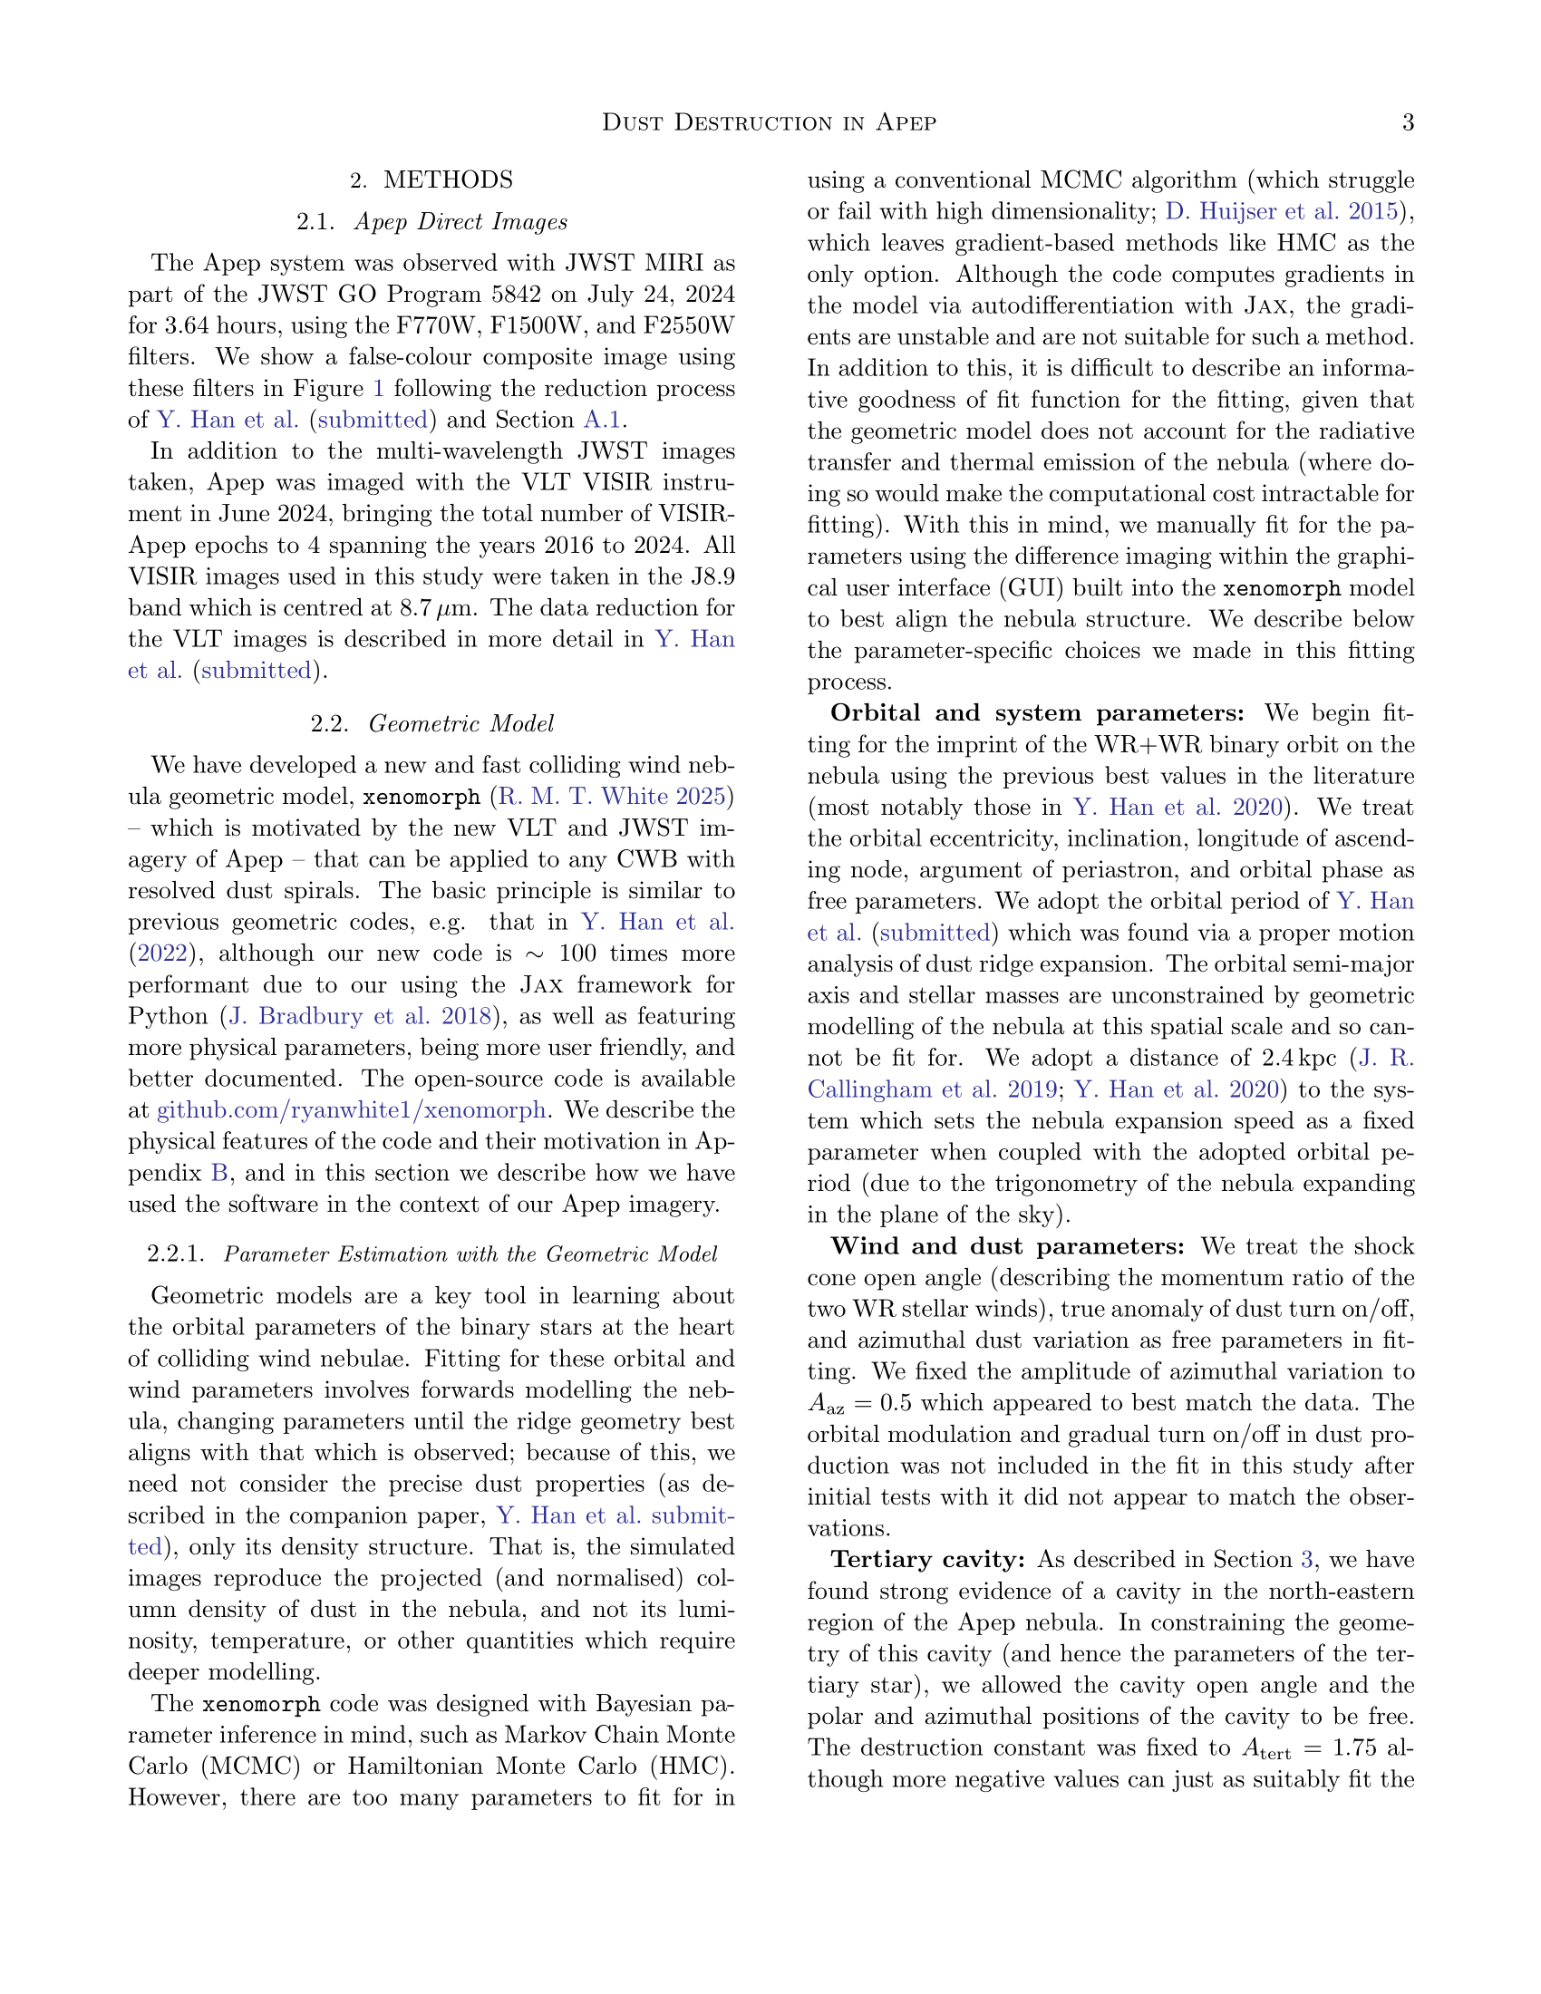
















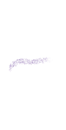



































































































































































































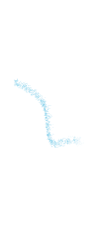

















































































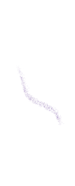





















































Double trouble?
Most of these Wolf-Rayet stars, like our Apep system, are in binary or higher order systems - systems where two or more stars orbit a common centre of mass. Each of these massive stars have their own wind, and so somewhere between the stars their winds collide which ‘shocks’ the wind, compressing it and mixing it together.
Our Wolf-Rayet star with the strong wind
The stronger wind overpowers the weaker one, creating this bow shock
Our other star with the weaker wind
The dust forms in this turbulent, post-shock mixture, once it’s had enough time to cool down
The orbital motion of the stars wraps this dust into a perfect spiral!

Slide 4
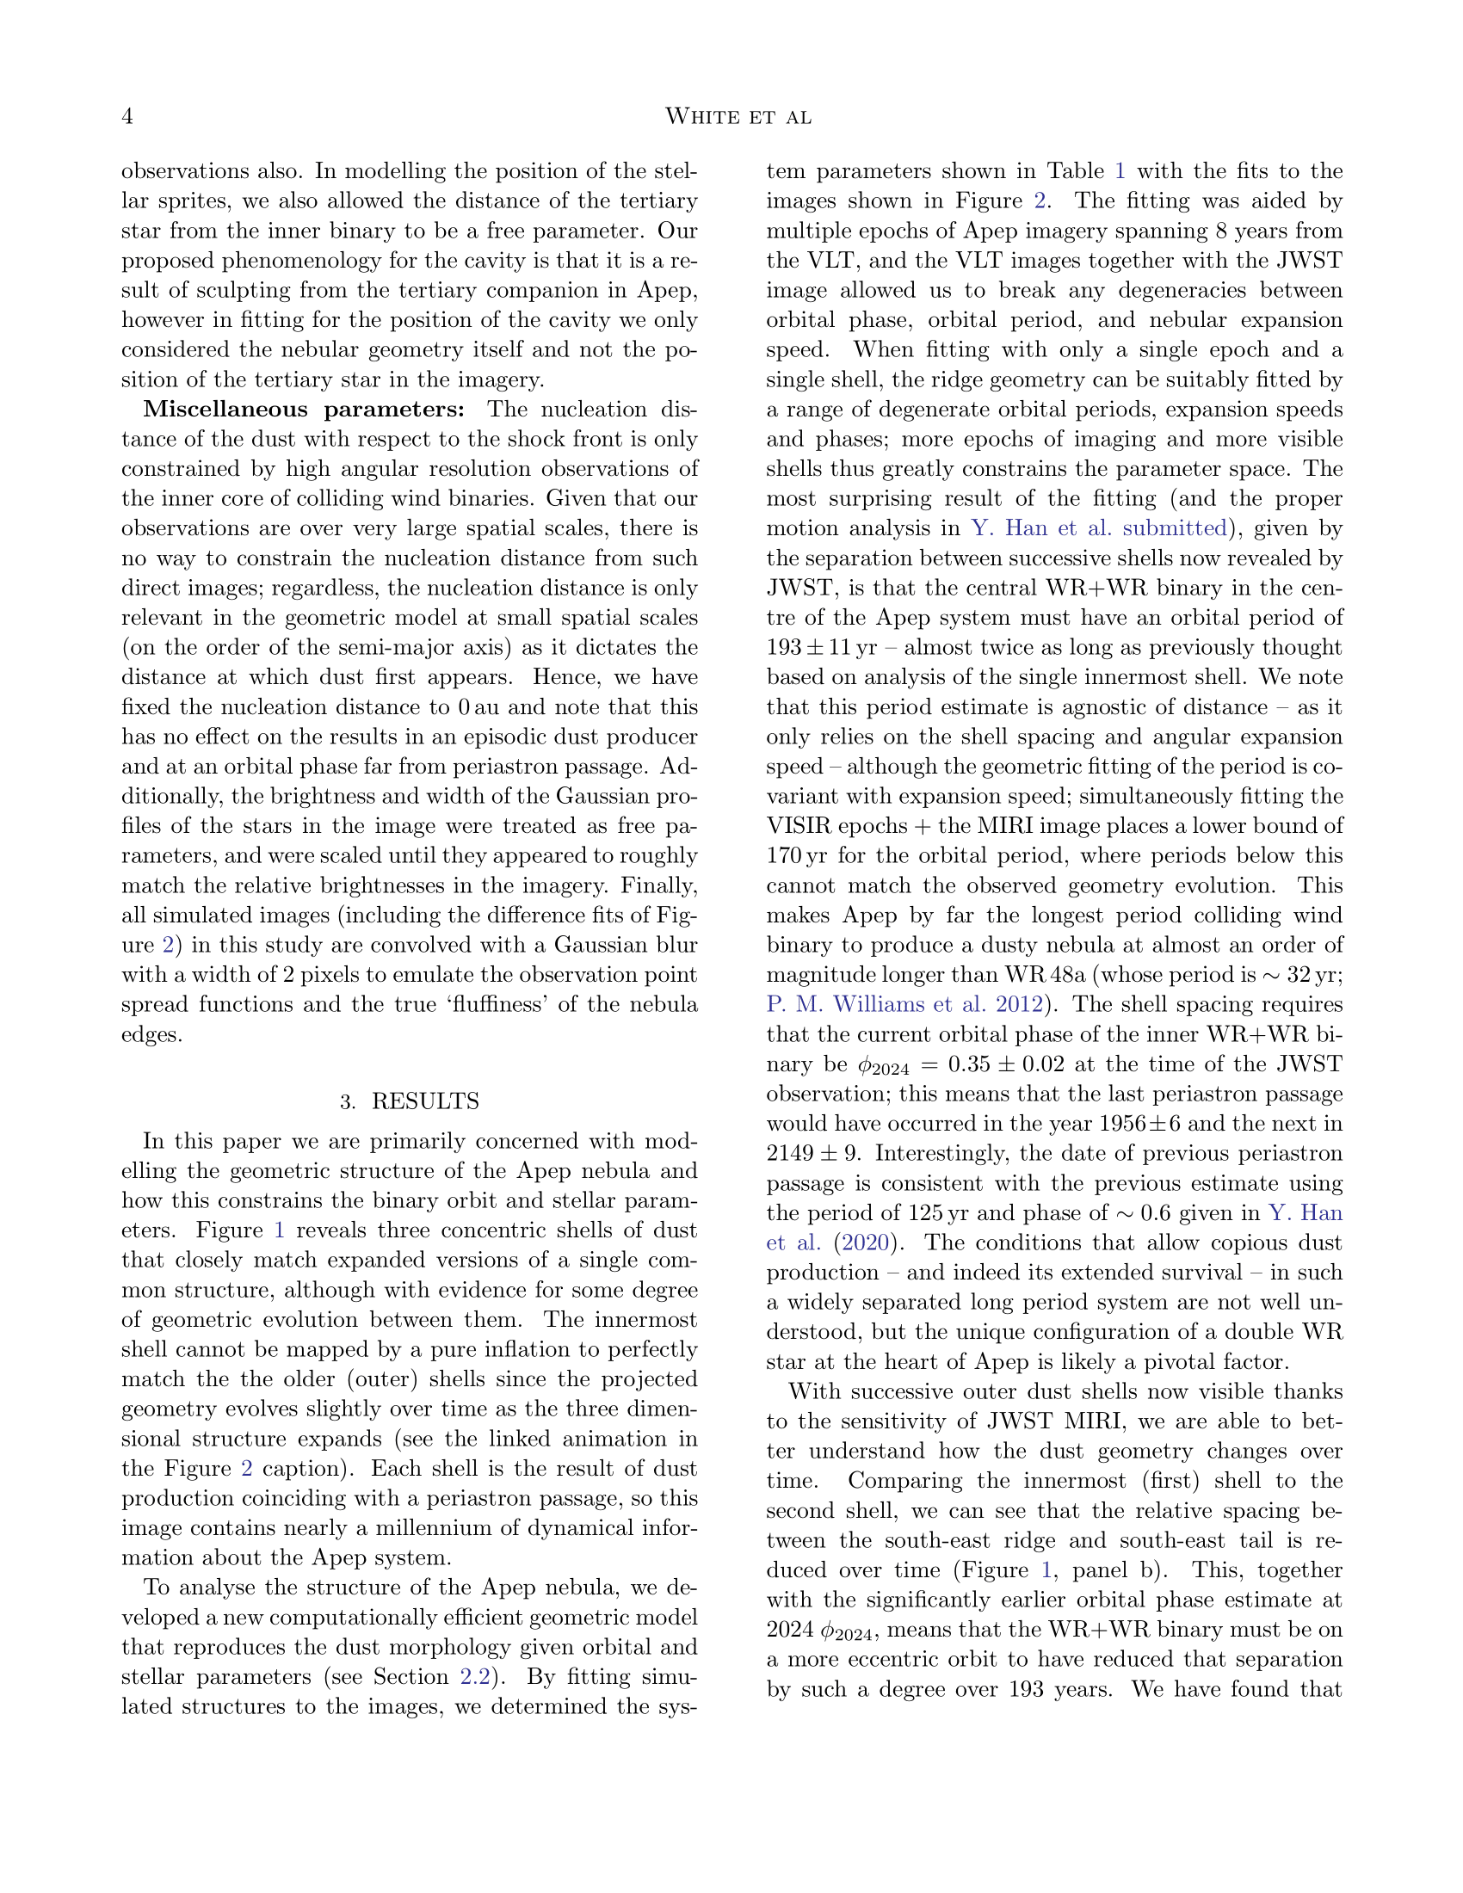























The exact shape of the dust spiral we see can tell us just about everything about the stars’ orbits, just from a single image. On this page, and the one before, we briefly describe the model we’ve made from scratch that can very quickly simulate the geometry of these nebulae. We go into much more detail in the last several pages, so stay tuned!
The first real image of this type of system was published by our co-author Peter Tuthill in 1999. The system’s name is WR 104, and it looked something like this
woah
WR 104 was observed with the Keck telescope on top of Mauna Kea in Hawaii. These spiral nebulae are brightest in the mid-infrared where we can see the warm thermal emission from the carbon dust, but the atmosphere blocks and distorts a lot of this light which dims and blurs the image. Ideally, we would want to use a very powerful infrared telescope that lives in space: the James Webb Space Telescope. We used exactly this to view the Apep system...

Slide 5
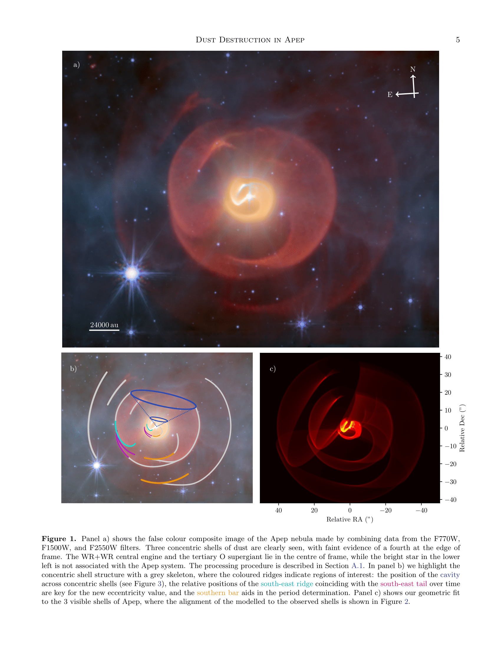
This is our *real* image!
~1 light year
This is our best model recreation of the nebula!
These are the features of the nebula that help us make the model

Slide 6
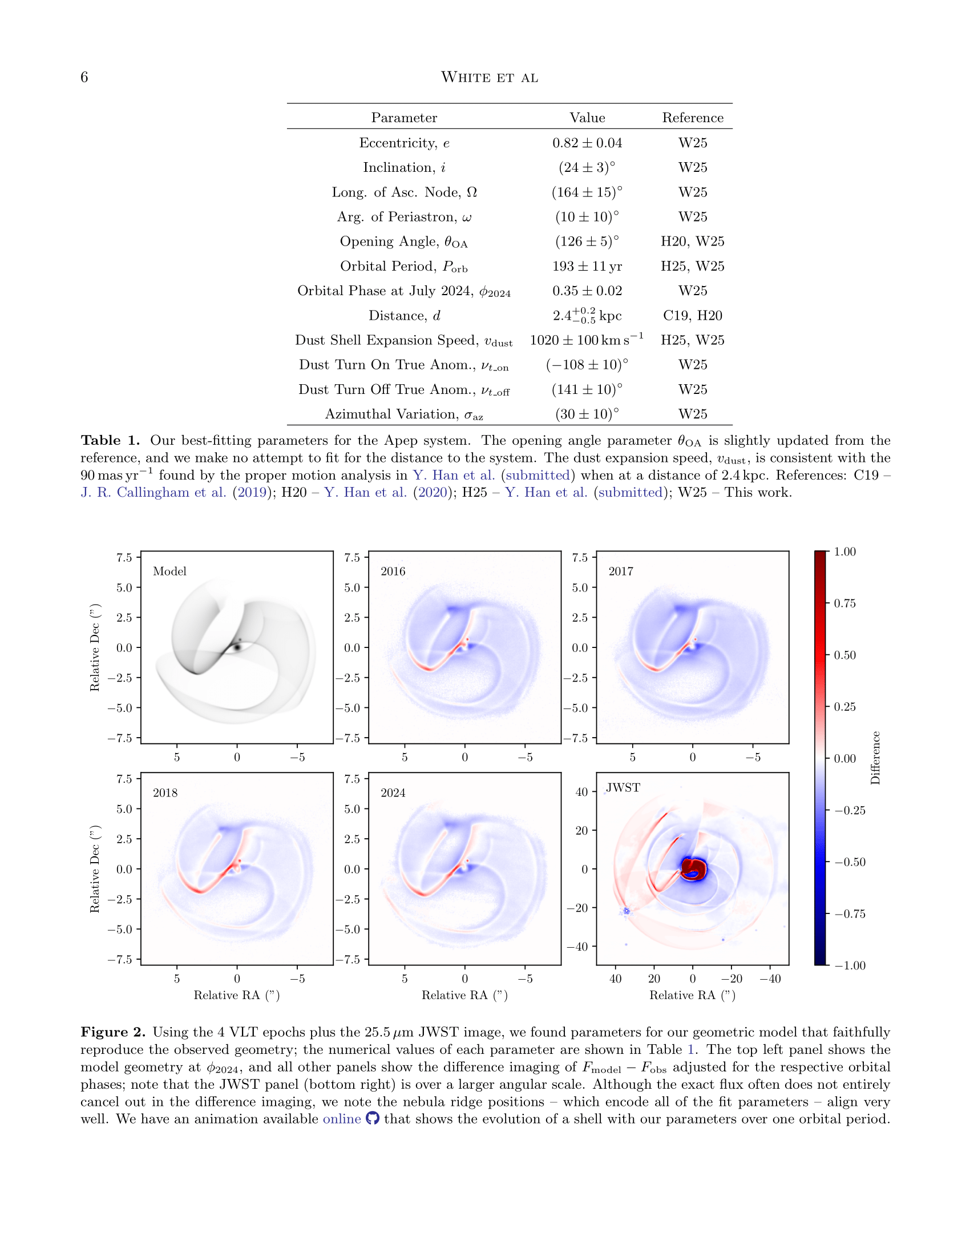
By modelling the 3D geometry of the nebula, we learn some pretty precise estimates of the orbits of the stars and what their winds are like. This helps us figure out what the lives of the stars have been like so far, and where they’ll end up.
One of the main results we find is that the two Wolf-Rayet stars have an orbital period of almost 200 years - almost 10 times as long as the next longest-period system that makes these nebulae. Apep is truly special!
To really make sure we have the right model, we compared our simulations with 5 different epochs of imagery, 4 images of the innermost shell taken by a ground-based telescope, and our beautiful JWST image.
In this plot we compare our simulations and our 8 years of data. Where the colour is blue, the data is ‘brighter’, and where the colour is red, the simulation is ‘brighter’. You can see that it doesn’t match up in colour perfectly, but the *outline* of our simulations matches the data exactly; this is good, because we learn our parameters from the outline of the match, not the intensity.

Slide 7
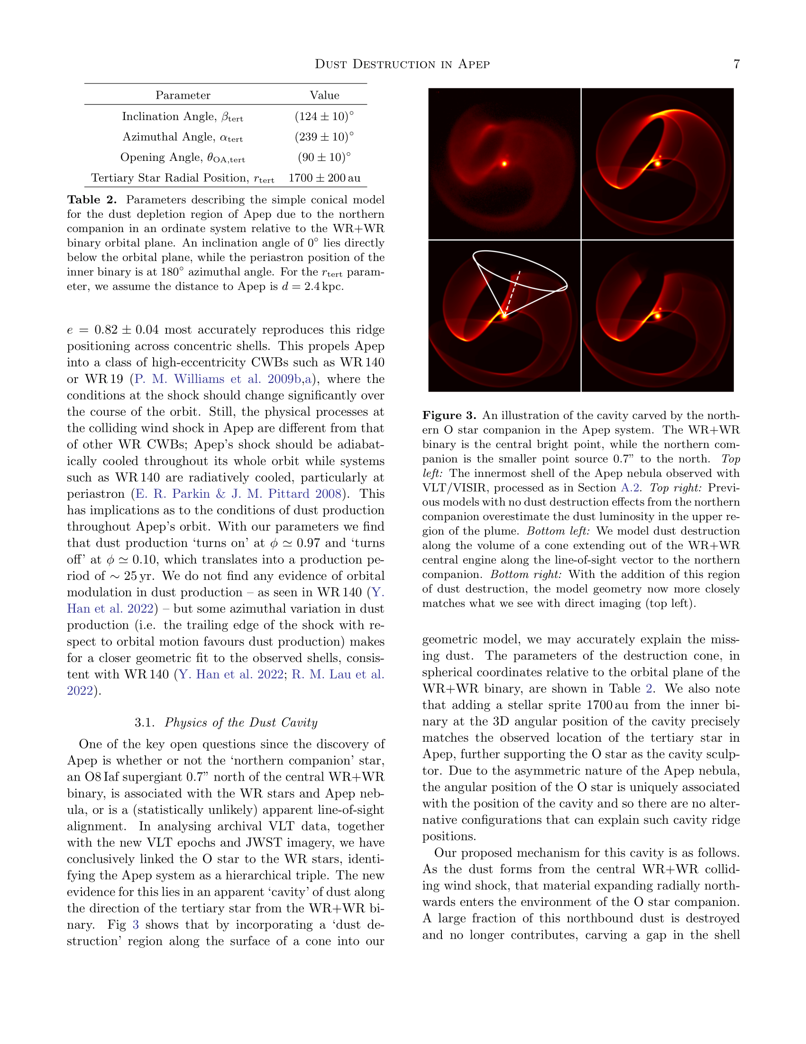

Slide 8
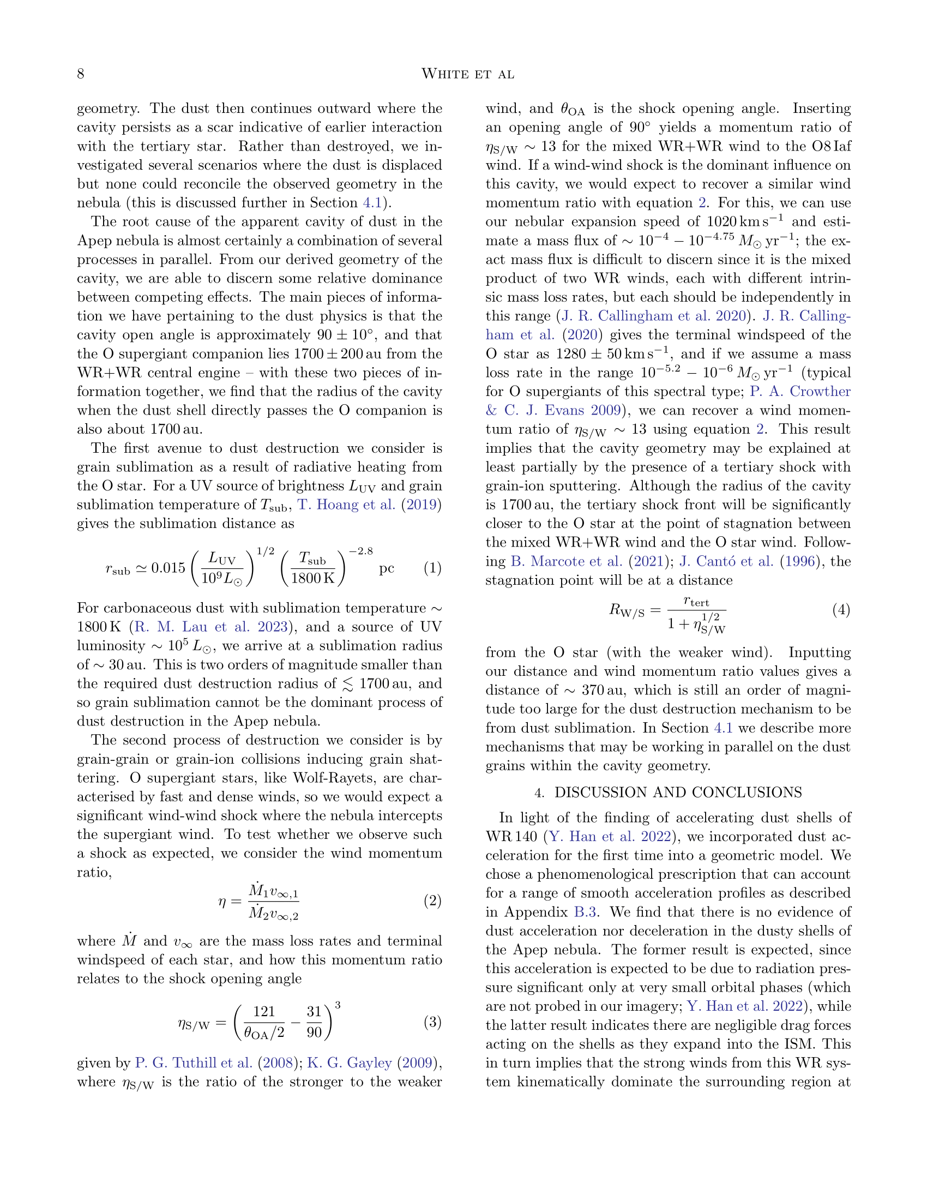

Slide 9
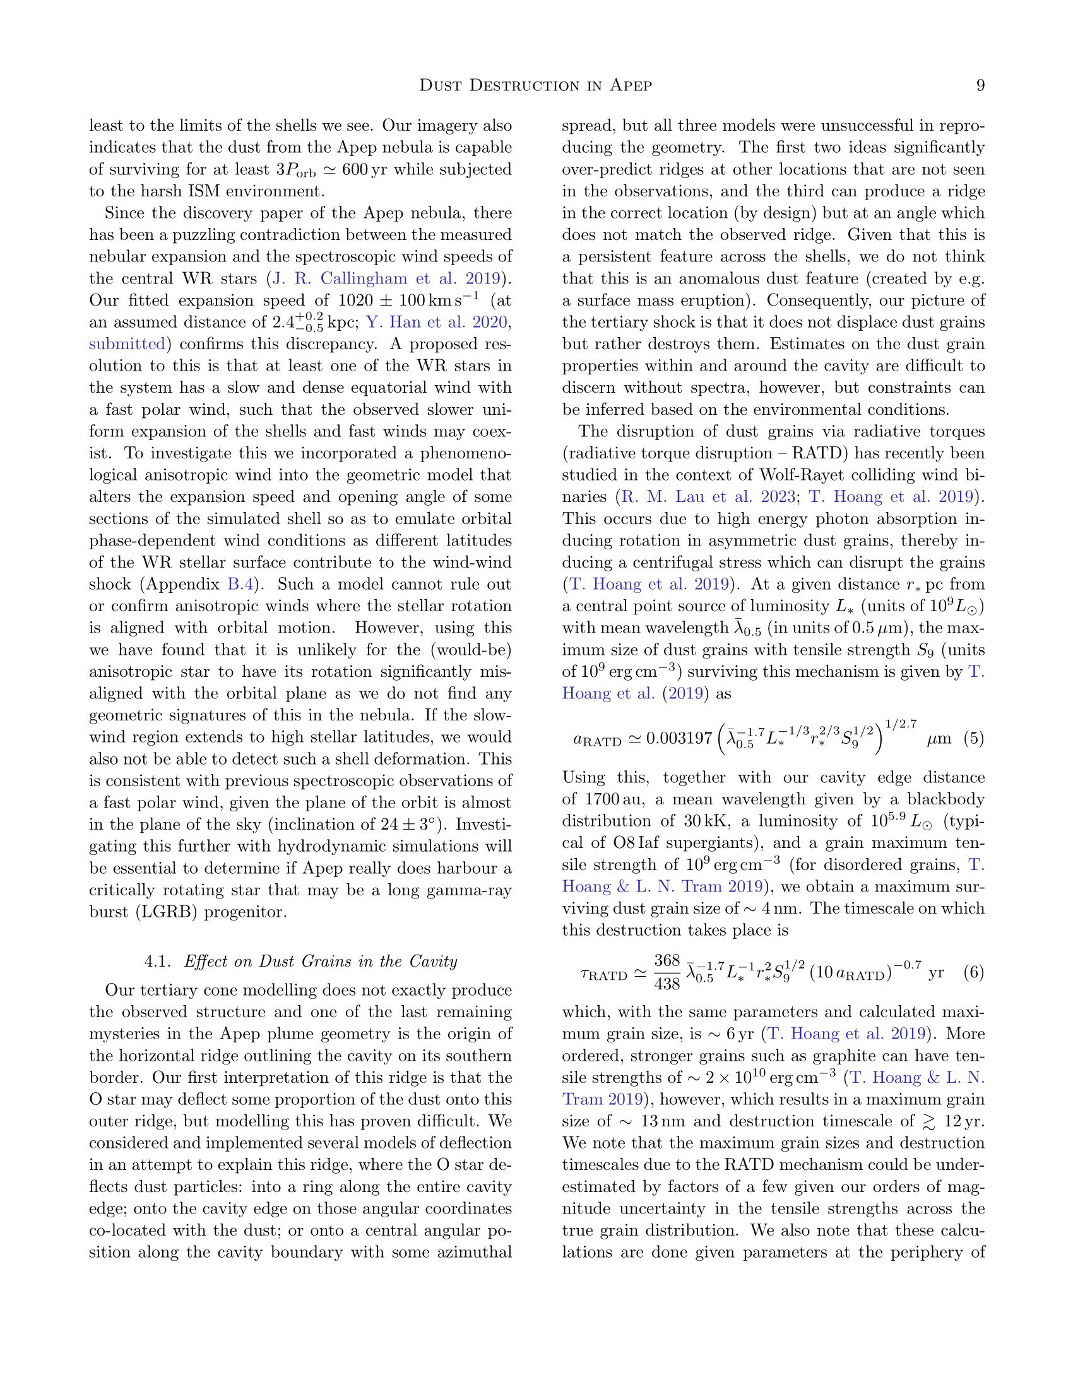

Slide 10
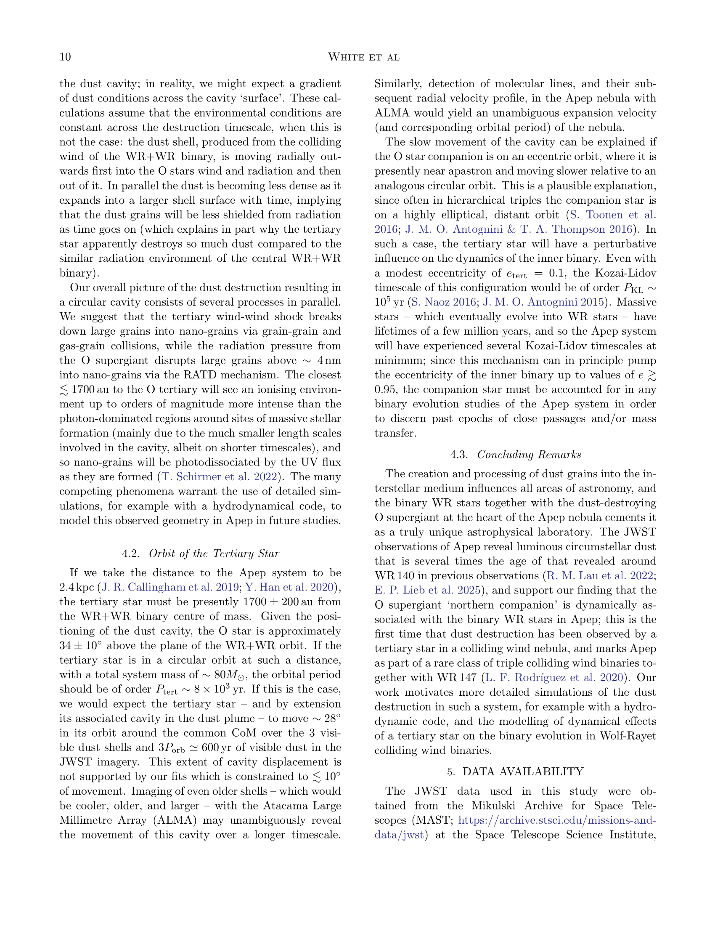

Slide 11
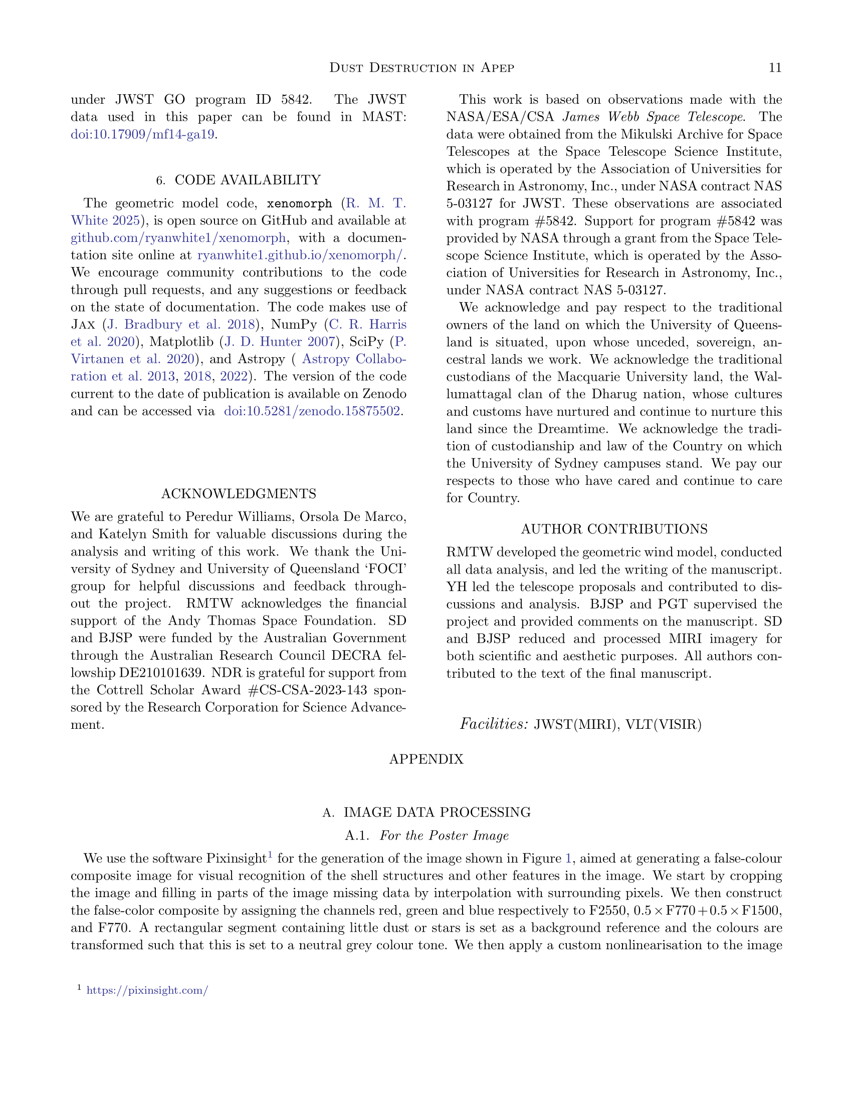

Slide 12
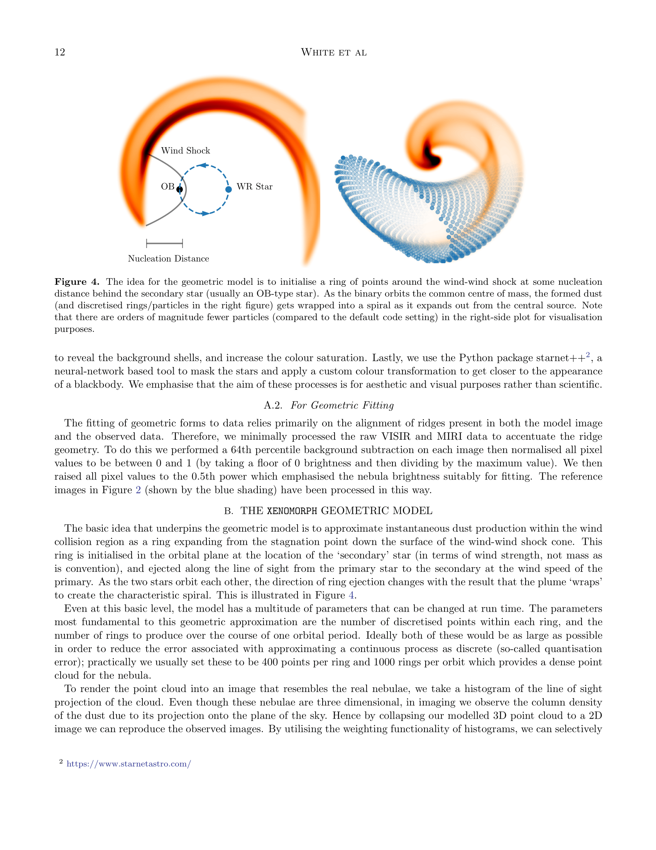

Slide 13
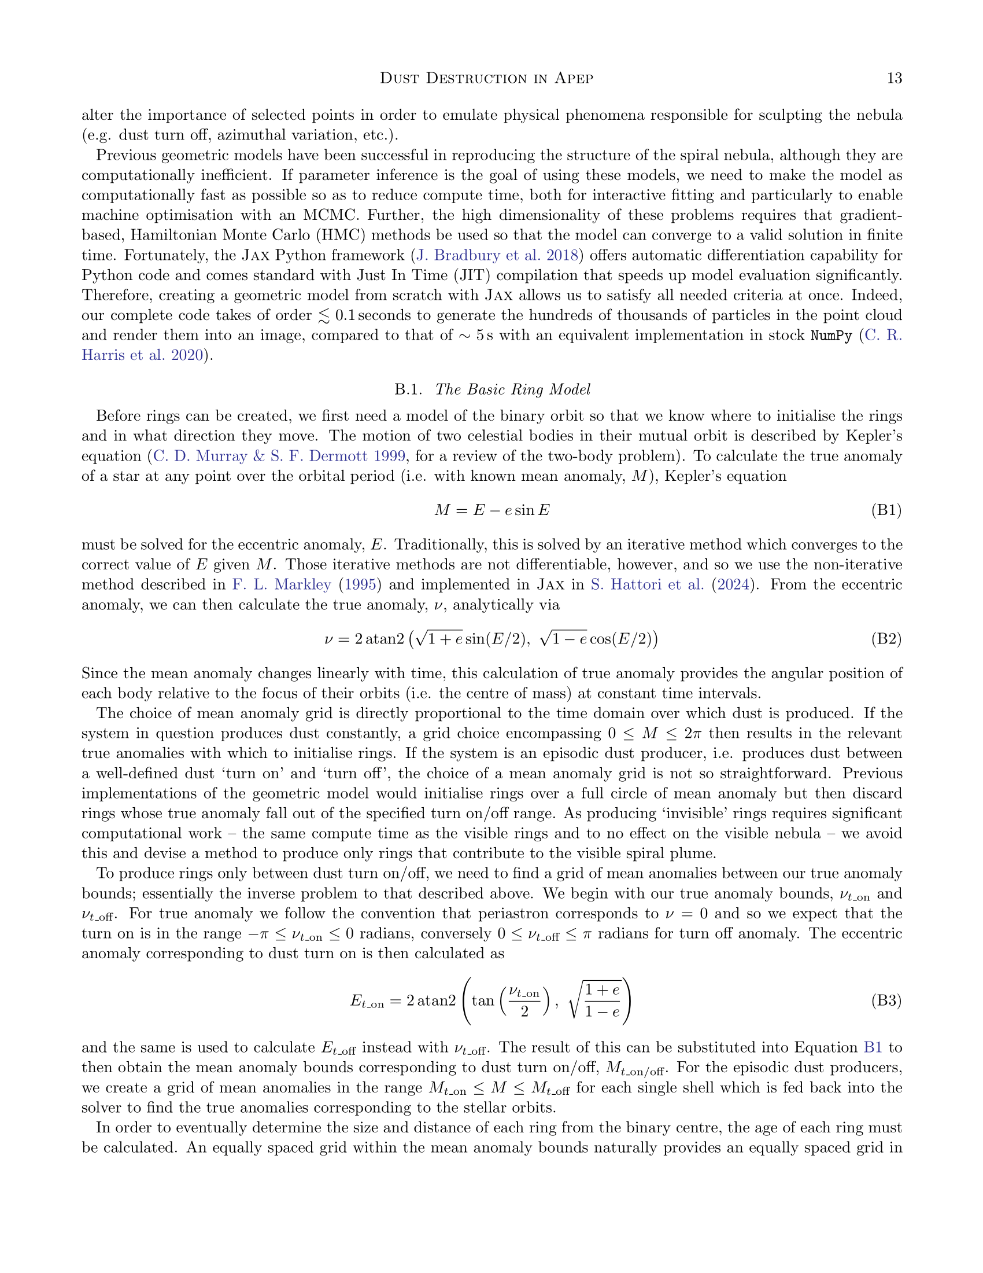

Slide 14
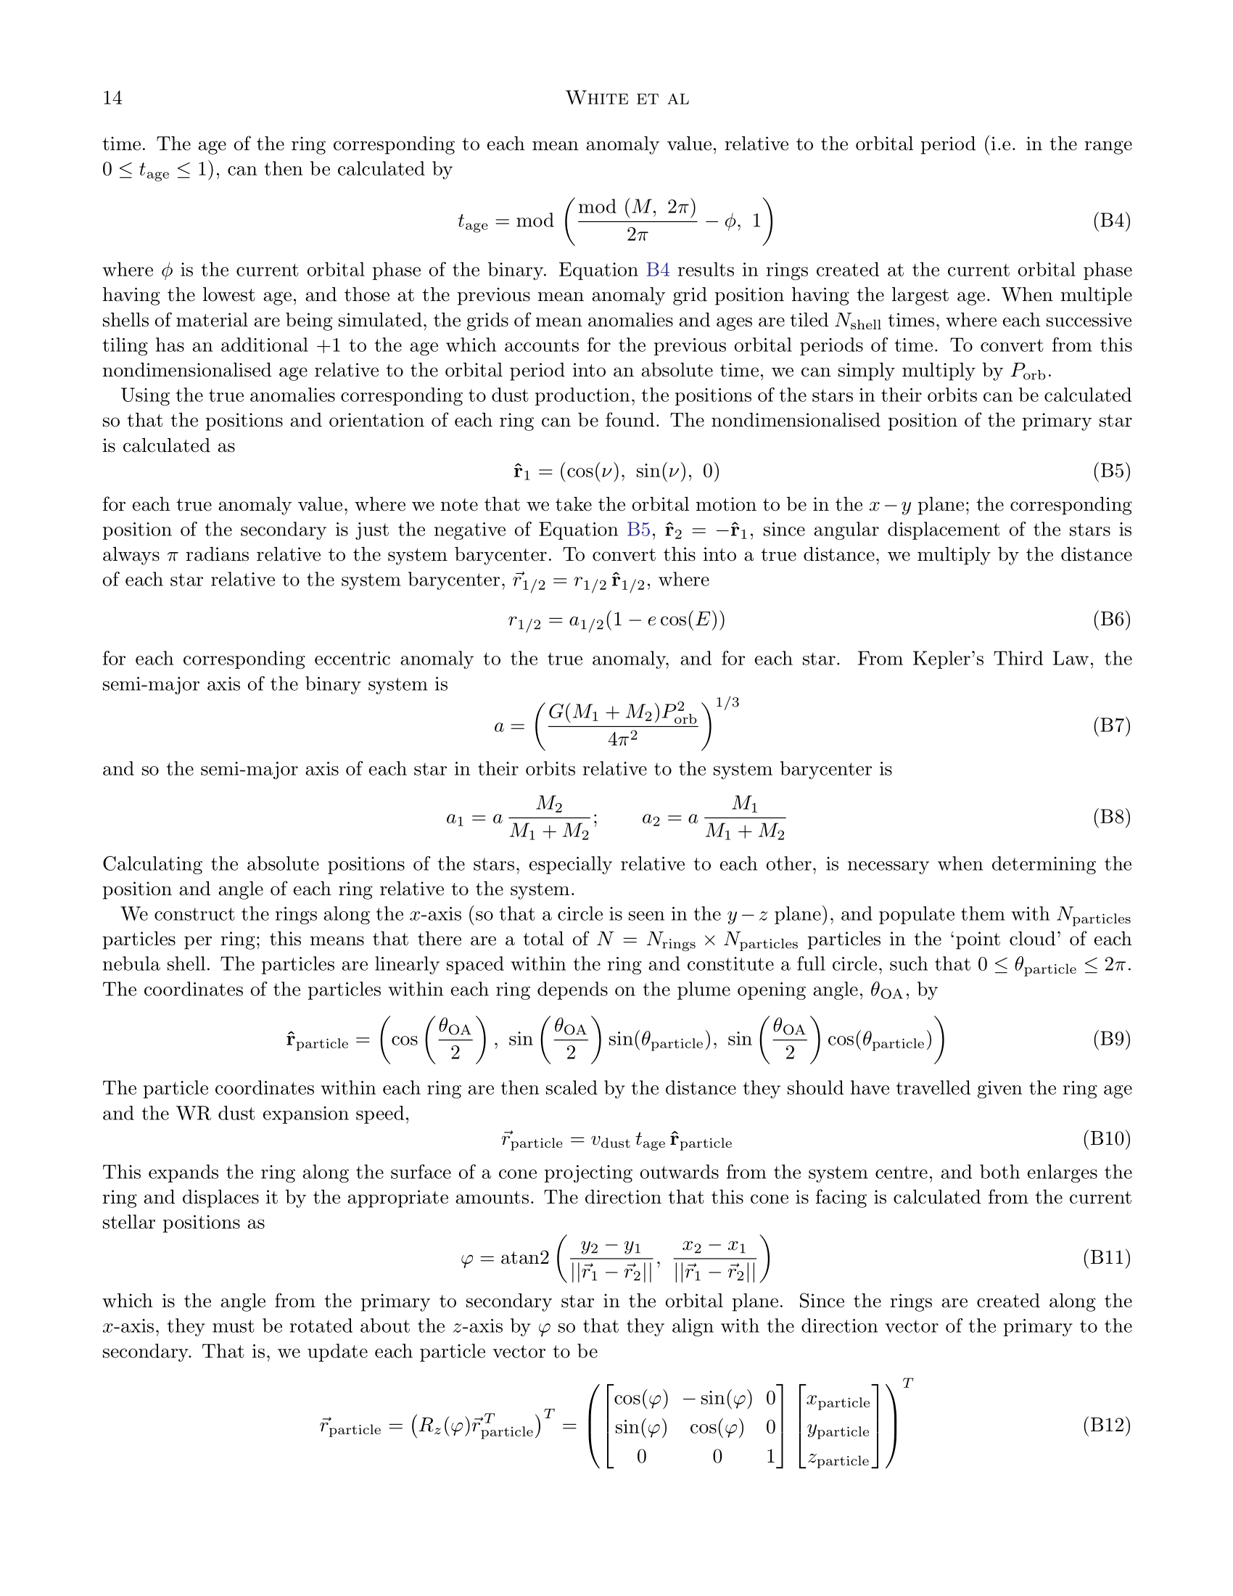

Slide 15
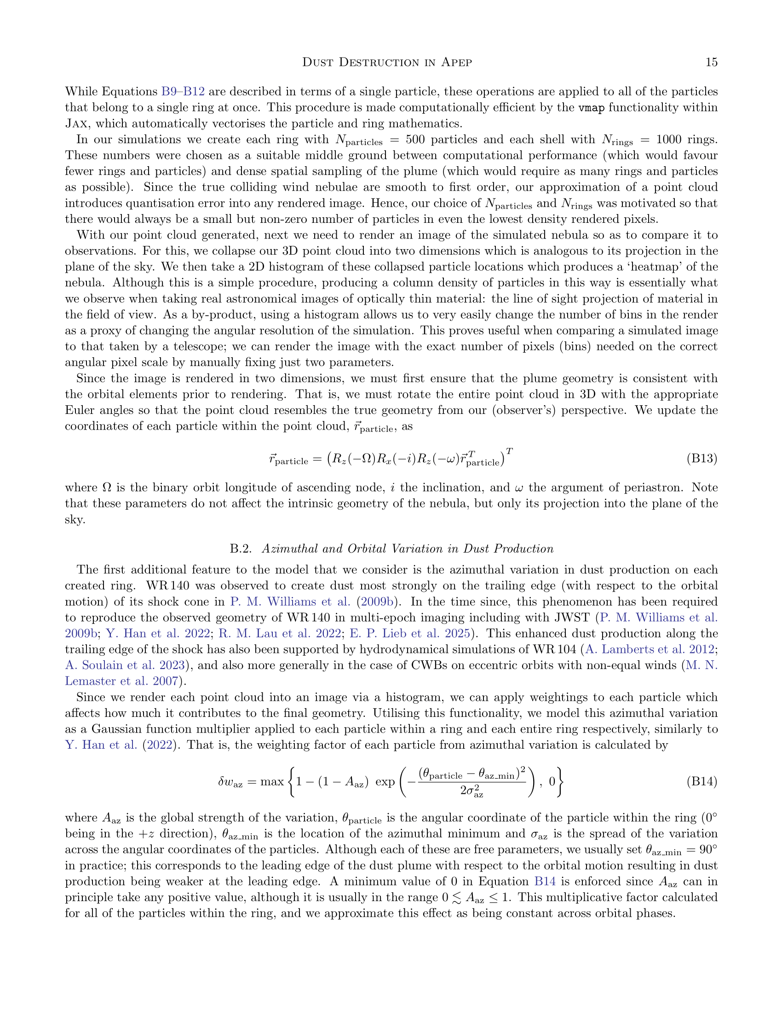

Slide 16
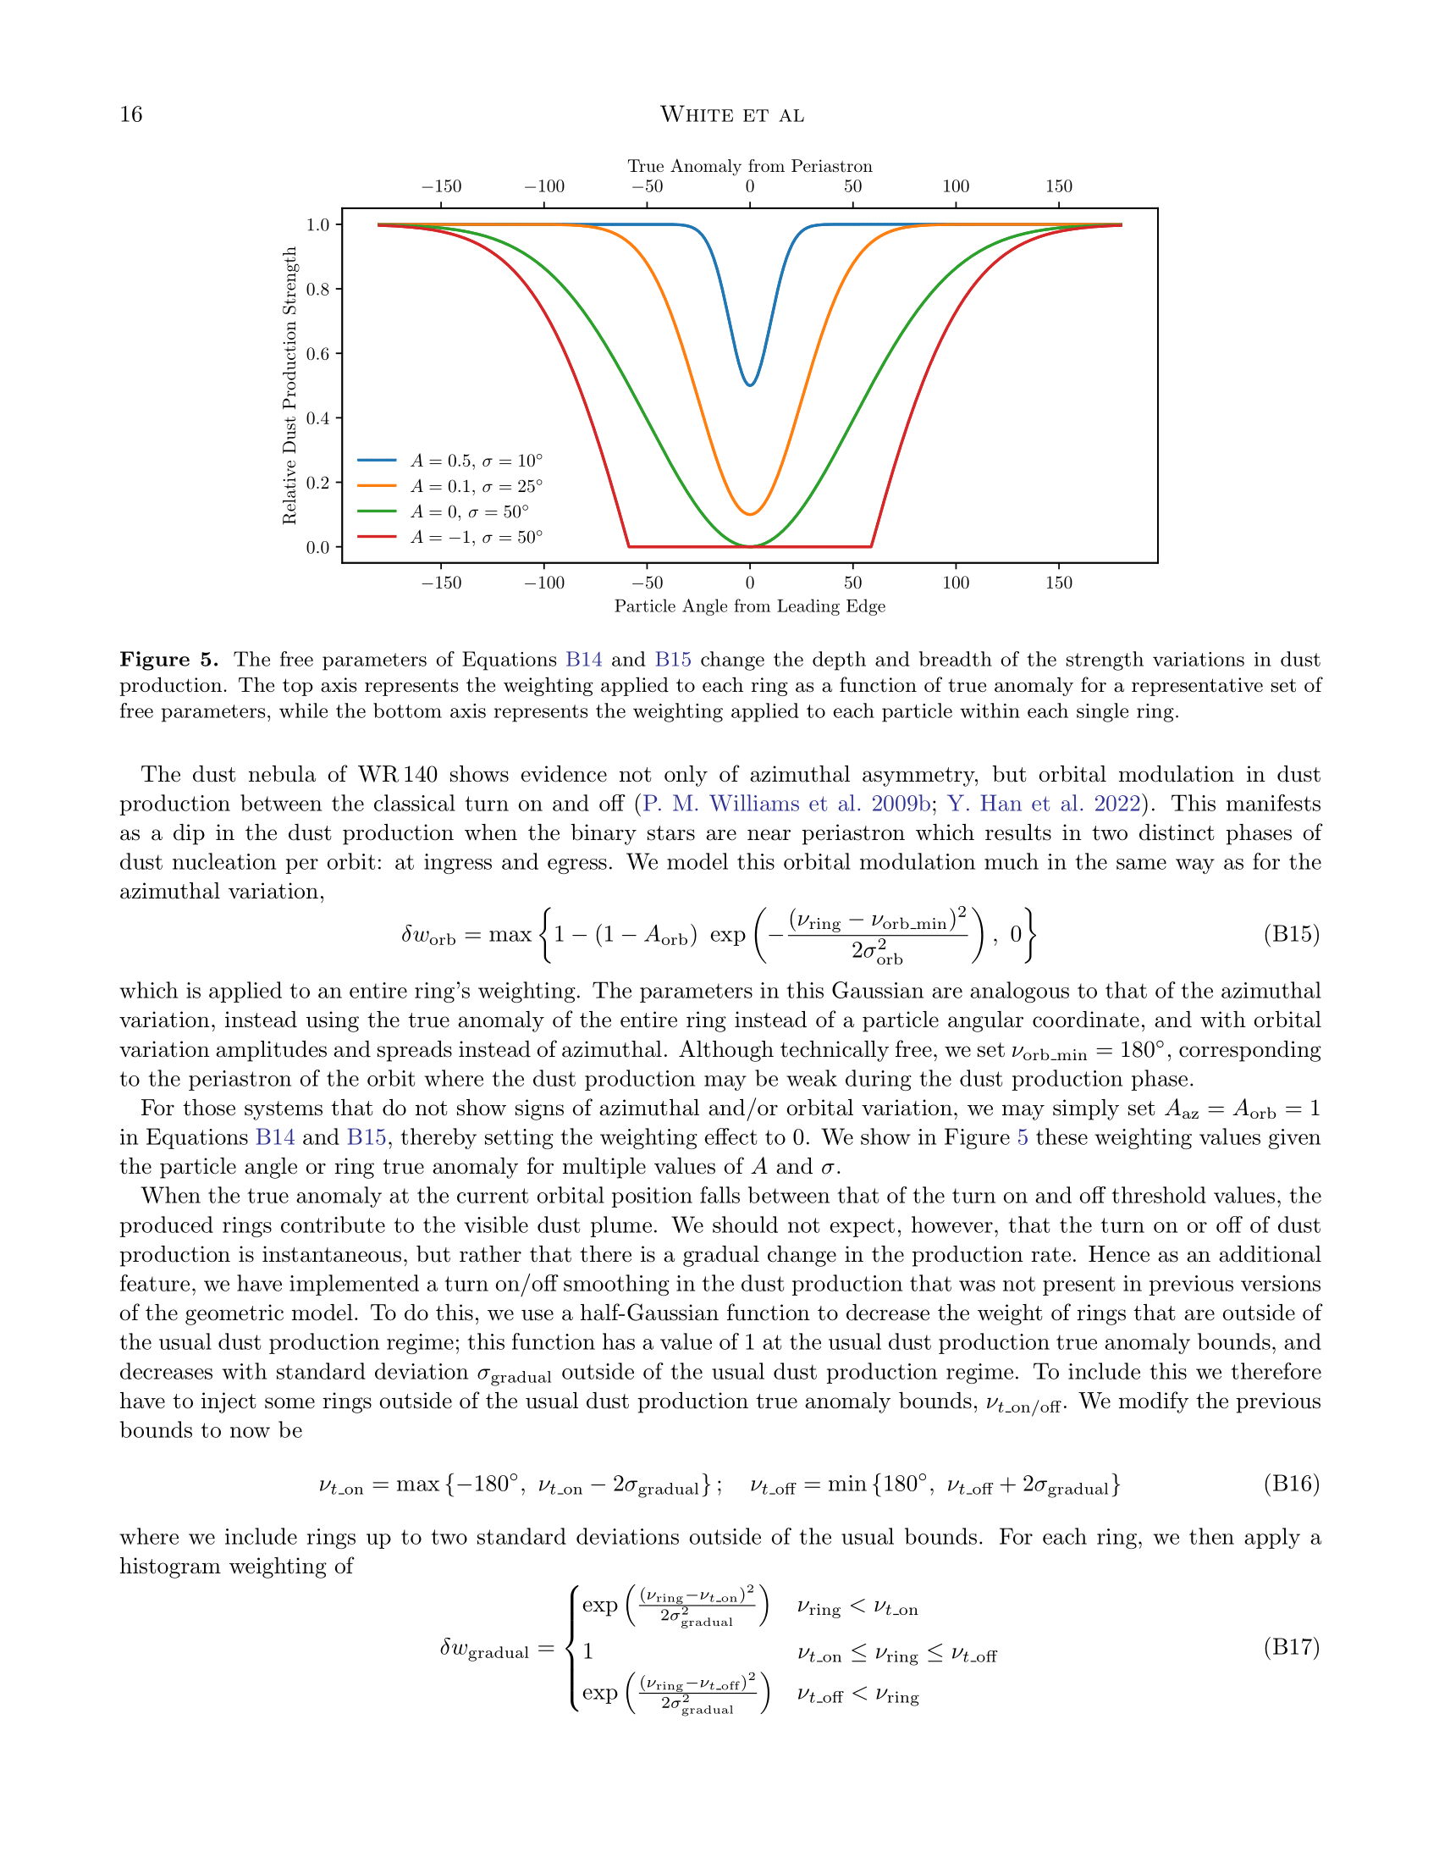

Slide 17
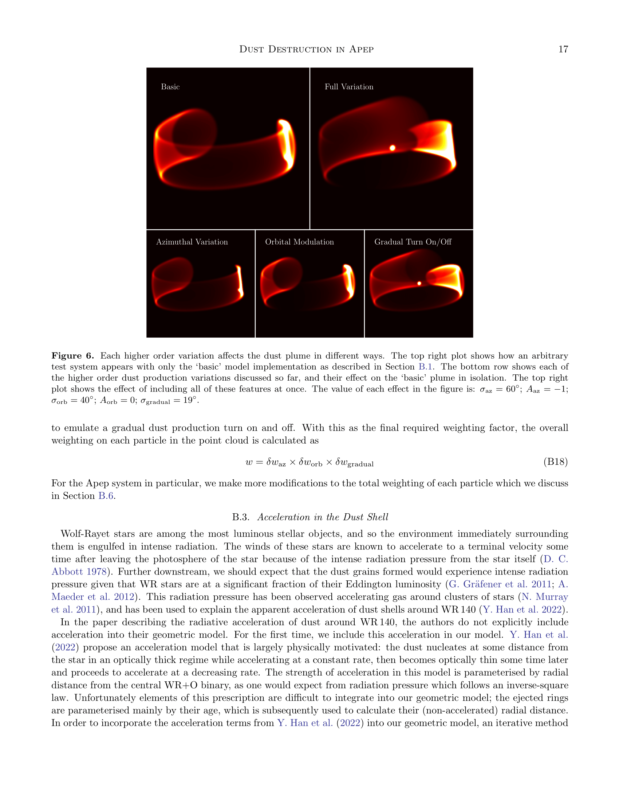

Slide 18
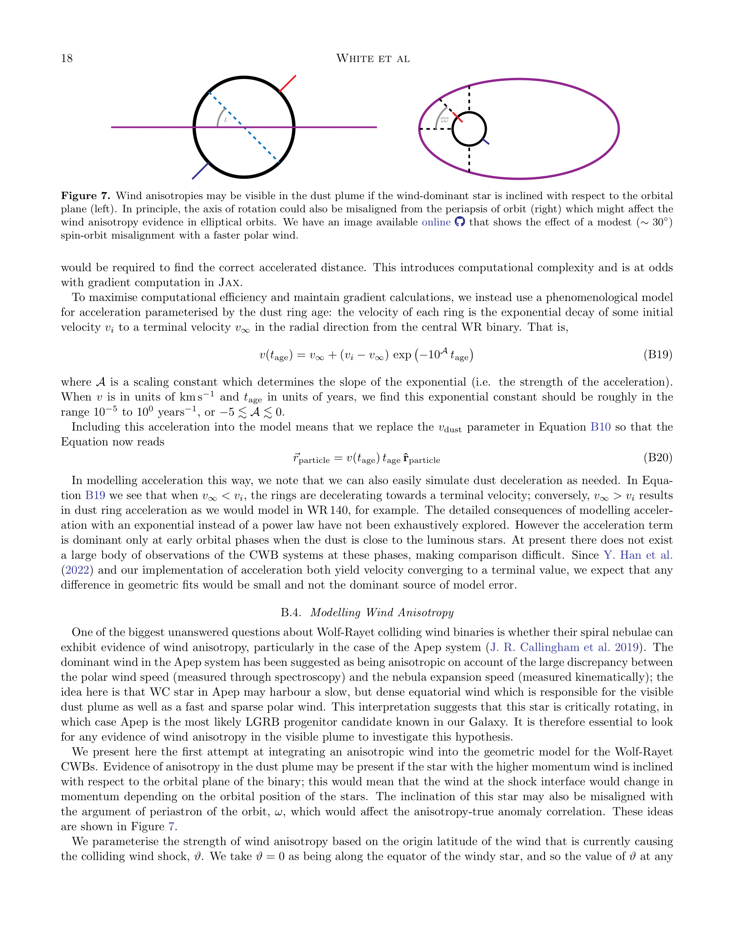

Slide 19
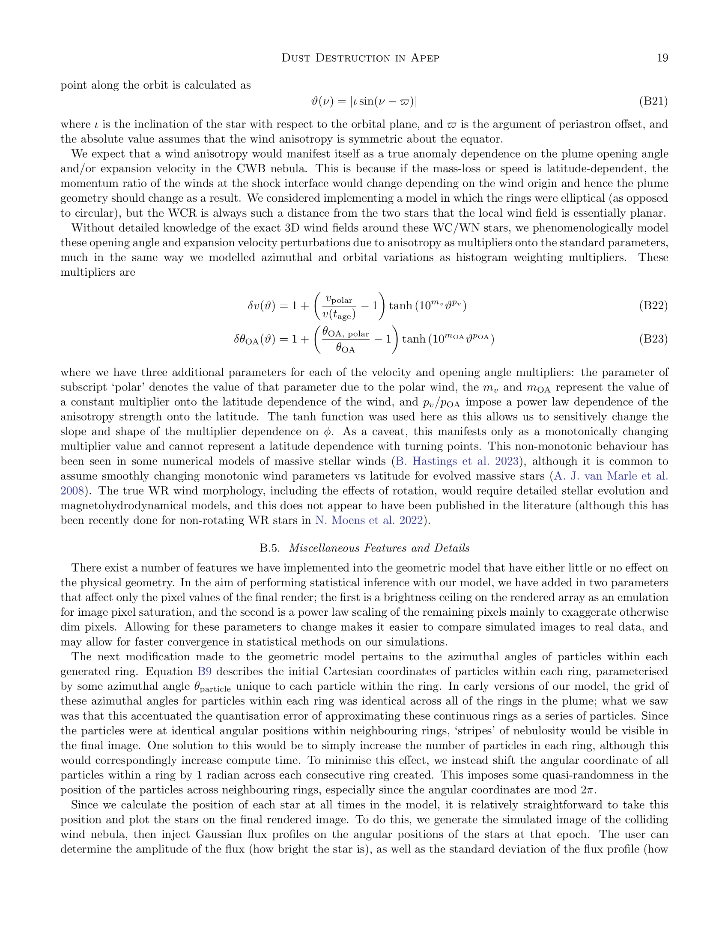

Slide 20
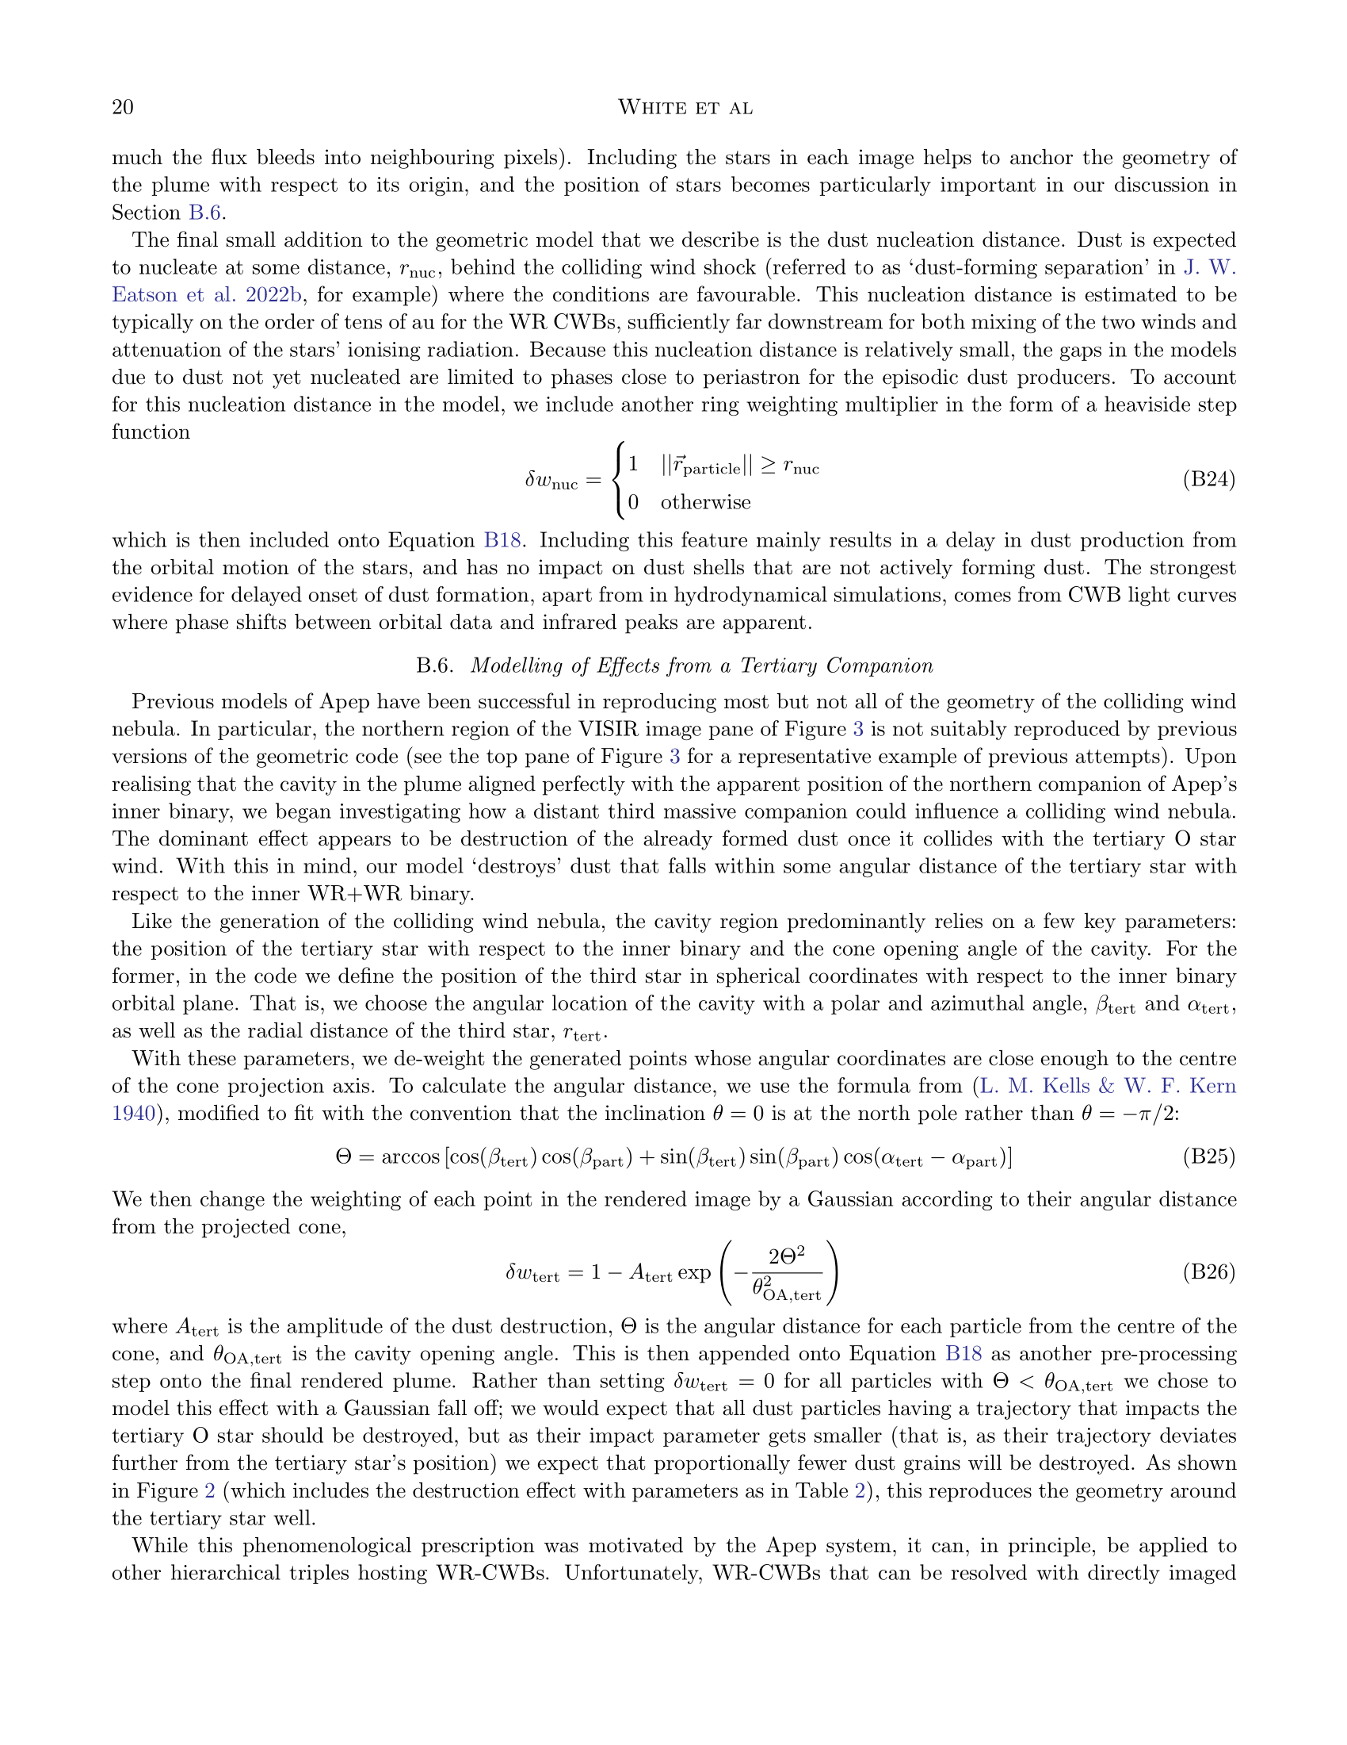

Slide 21
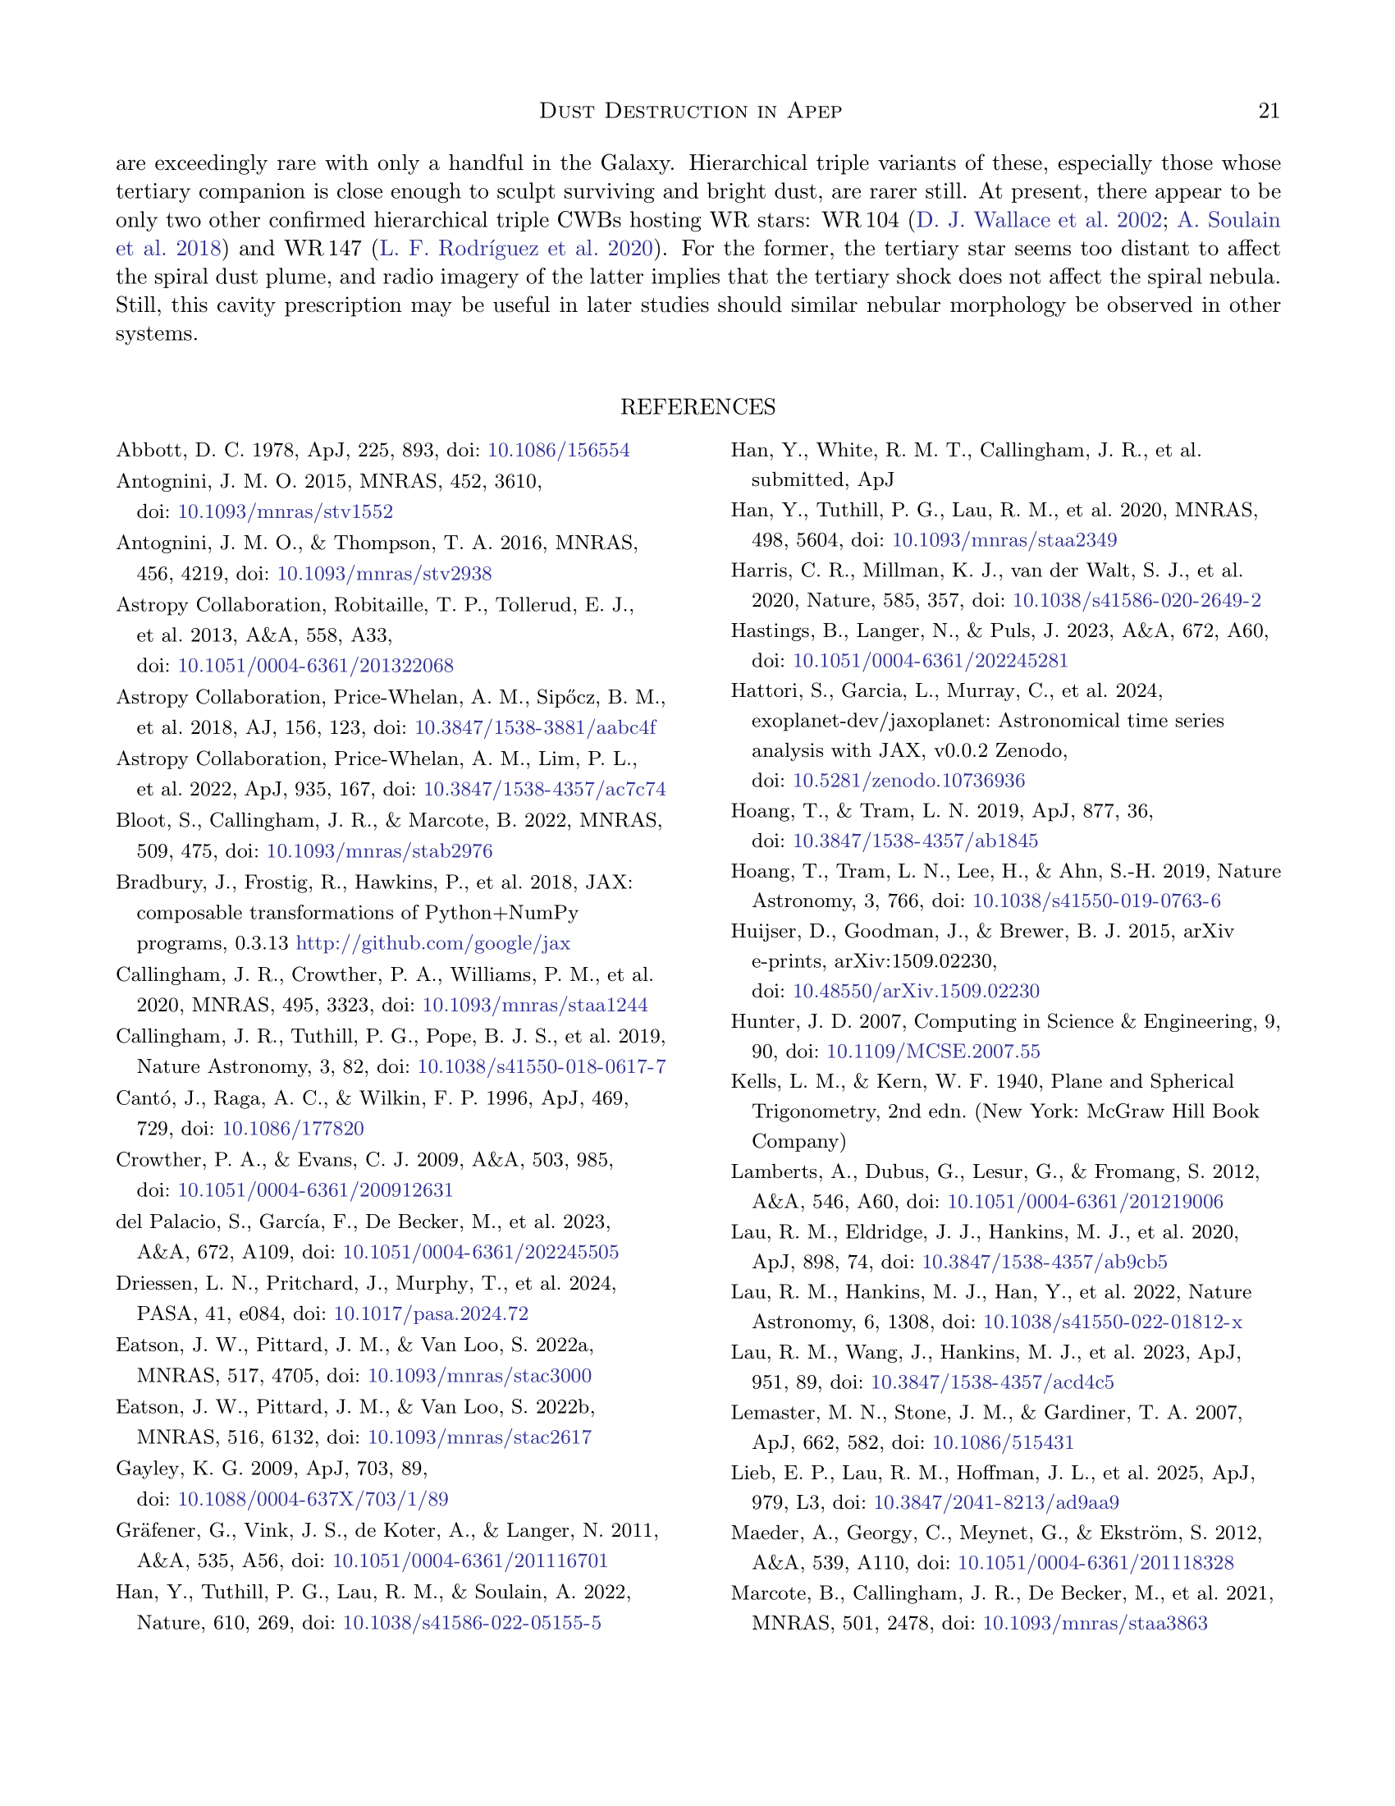

Slide 22
